Slide 1
1/29 Weekly Meeting
JetRacer Capstone

Slide 2
General Progress
Setup ROS and LIDAR packages on Jetson Nano
Learned capabilities of LIDAR, ran point cloud visualization
3D printed brackets for mounting components
Worked on CV algorithm
PCB development

Slide 3
LIDAR: Arjun Simha
Previous Work:
Setup LIDAR on Windows machine and tested capabilities
Downloaded ROS packages on Jetson Nano
Downloaded LIDAR drivers and ROS library on Jetson Nano
Ran LIDAR rviz on Nano, visualized point cloud
Future Work:
SLAM
Continue to explore LIDAR capabilities
Mount LIDAR on car
Use/apply LIDAR data to inform car

Slide 4
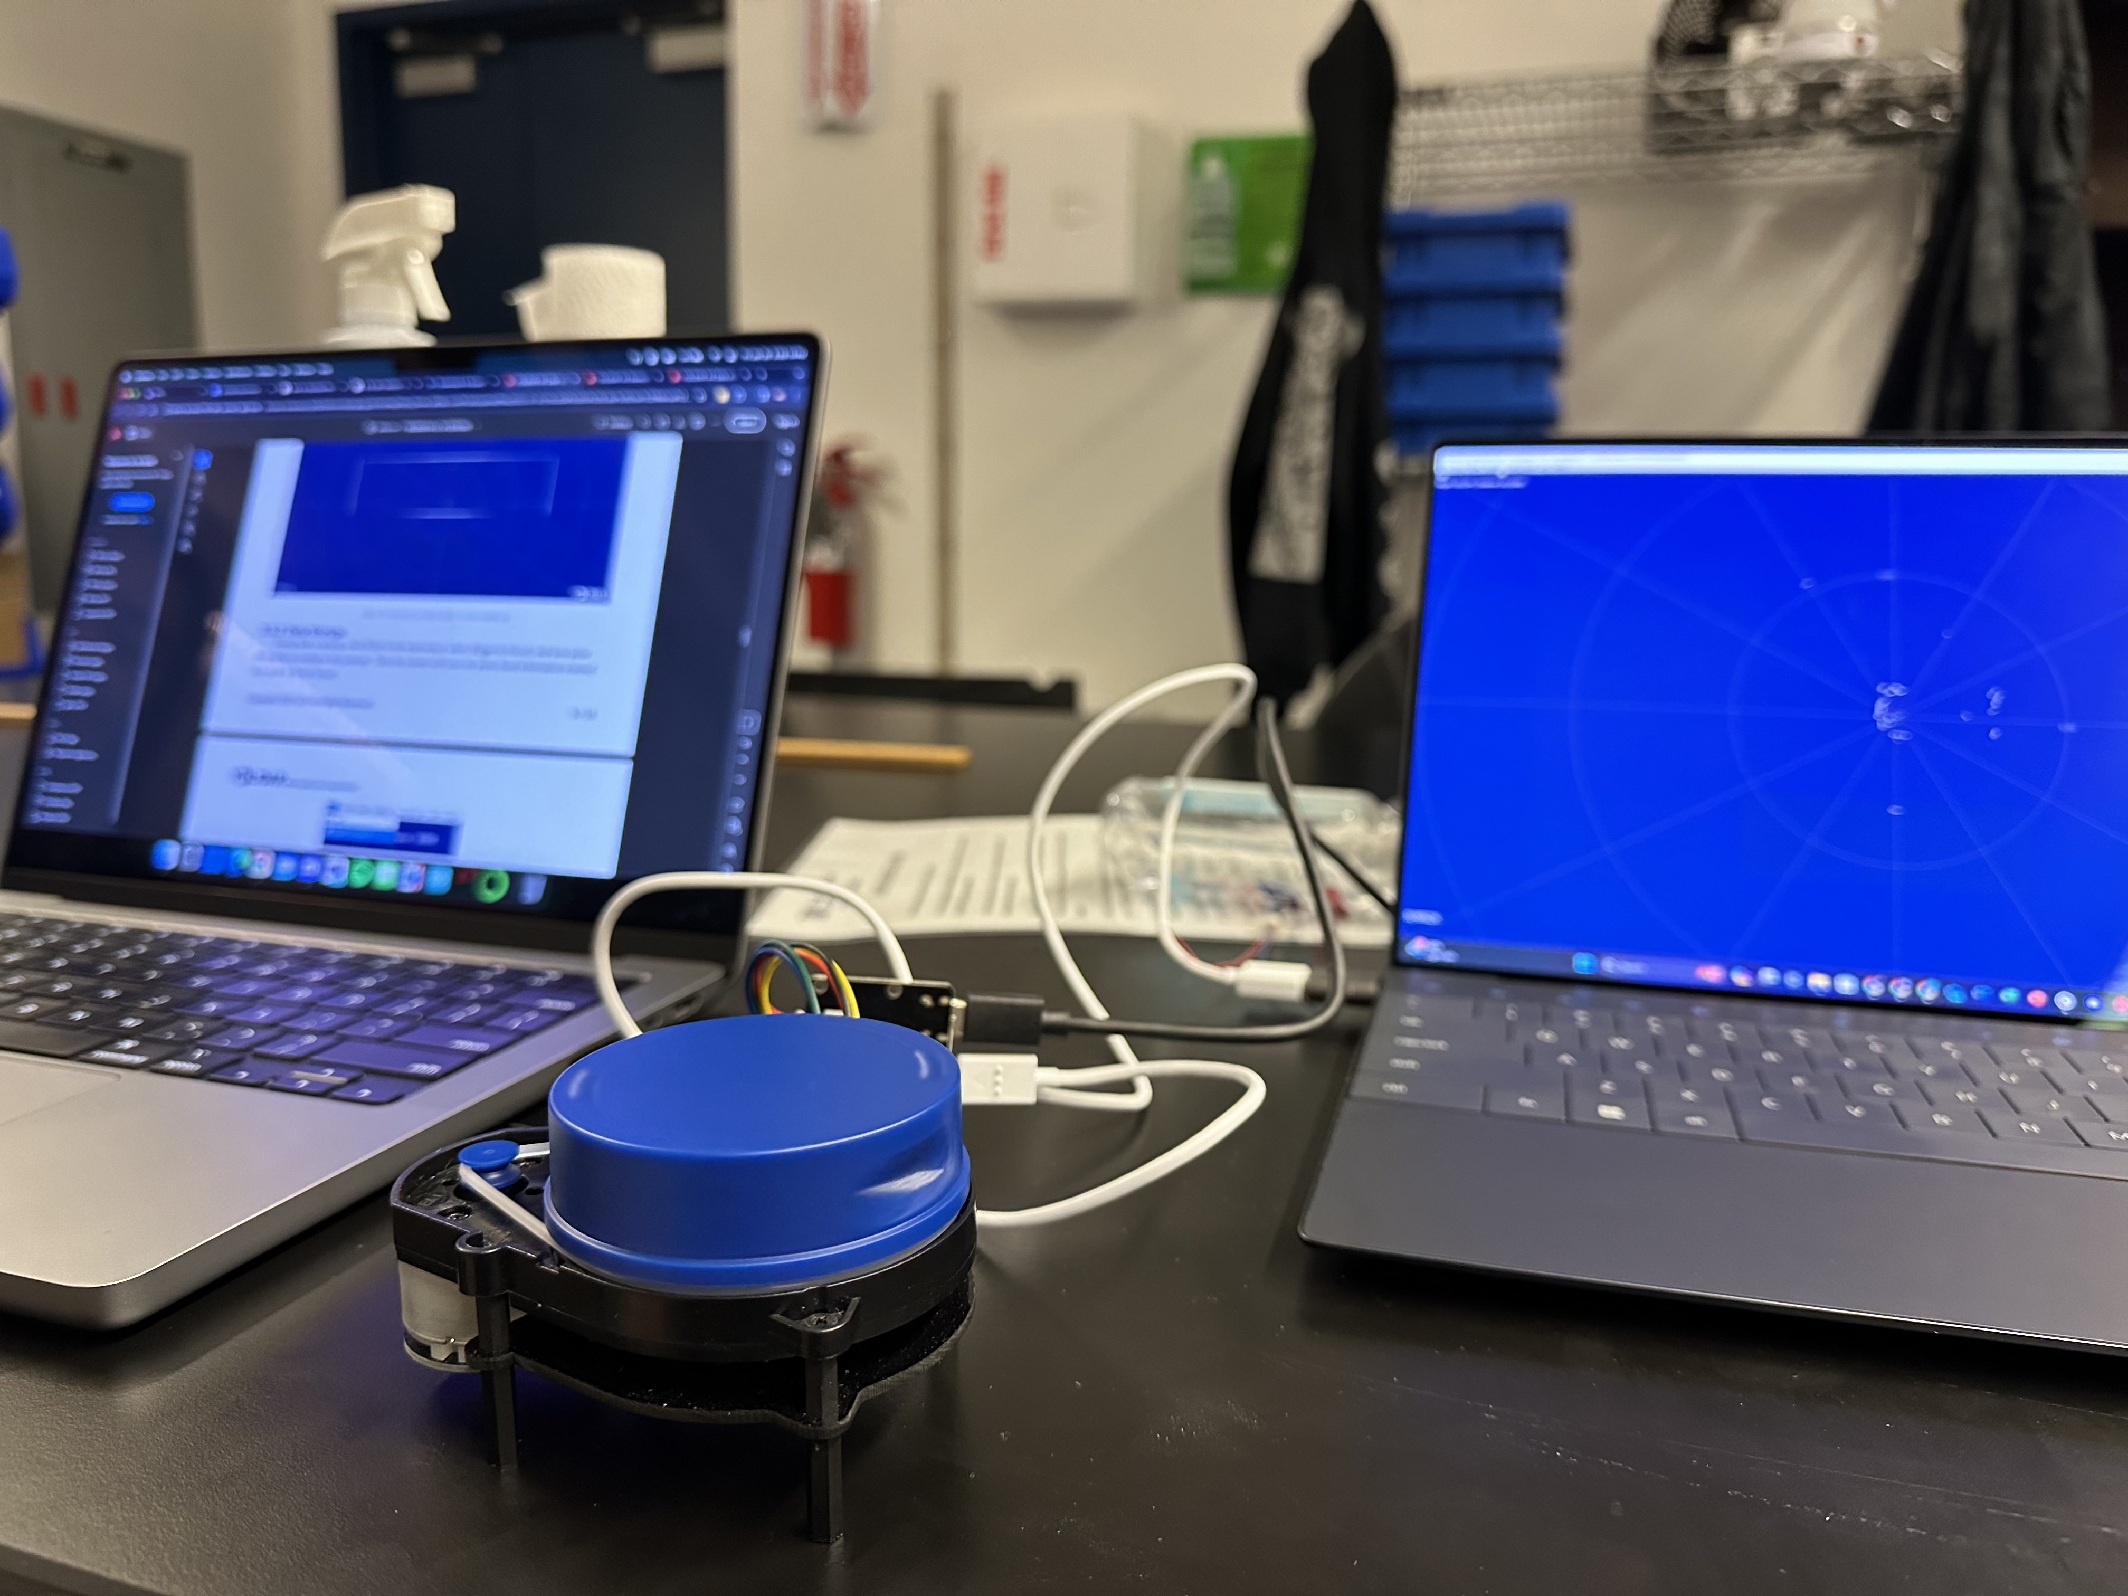
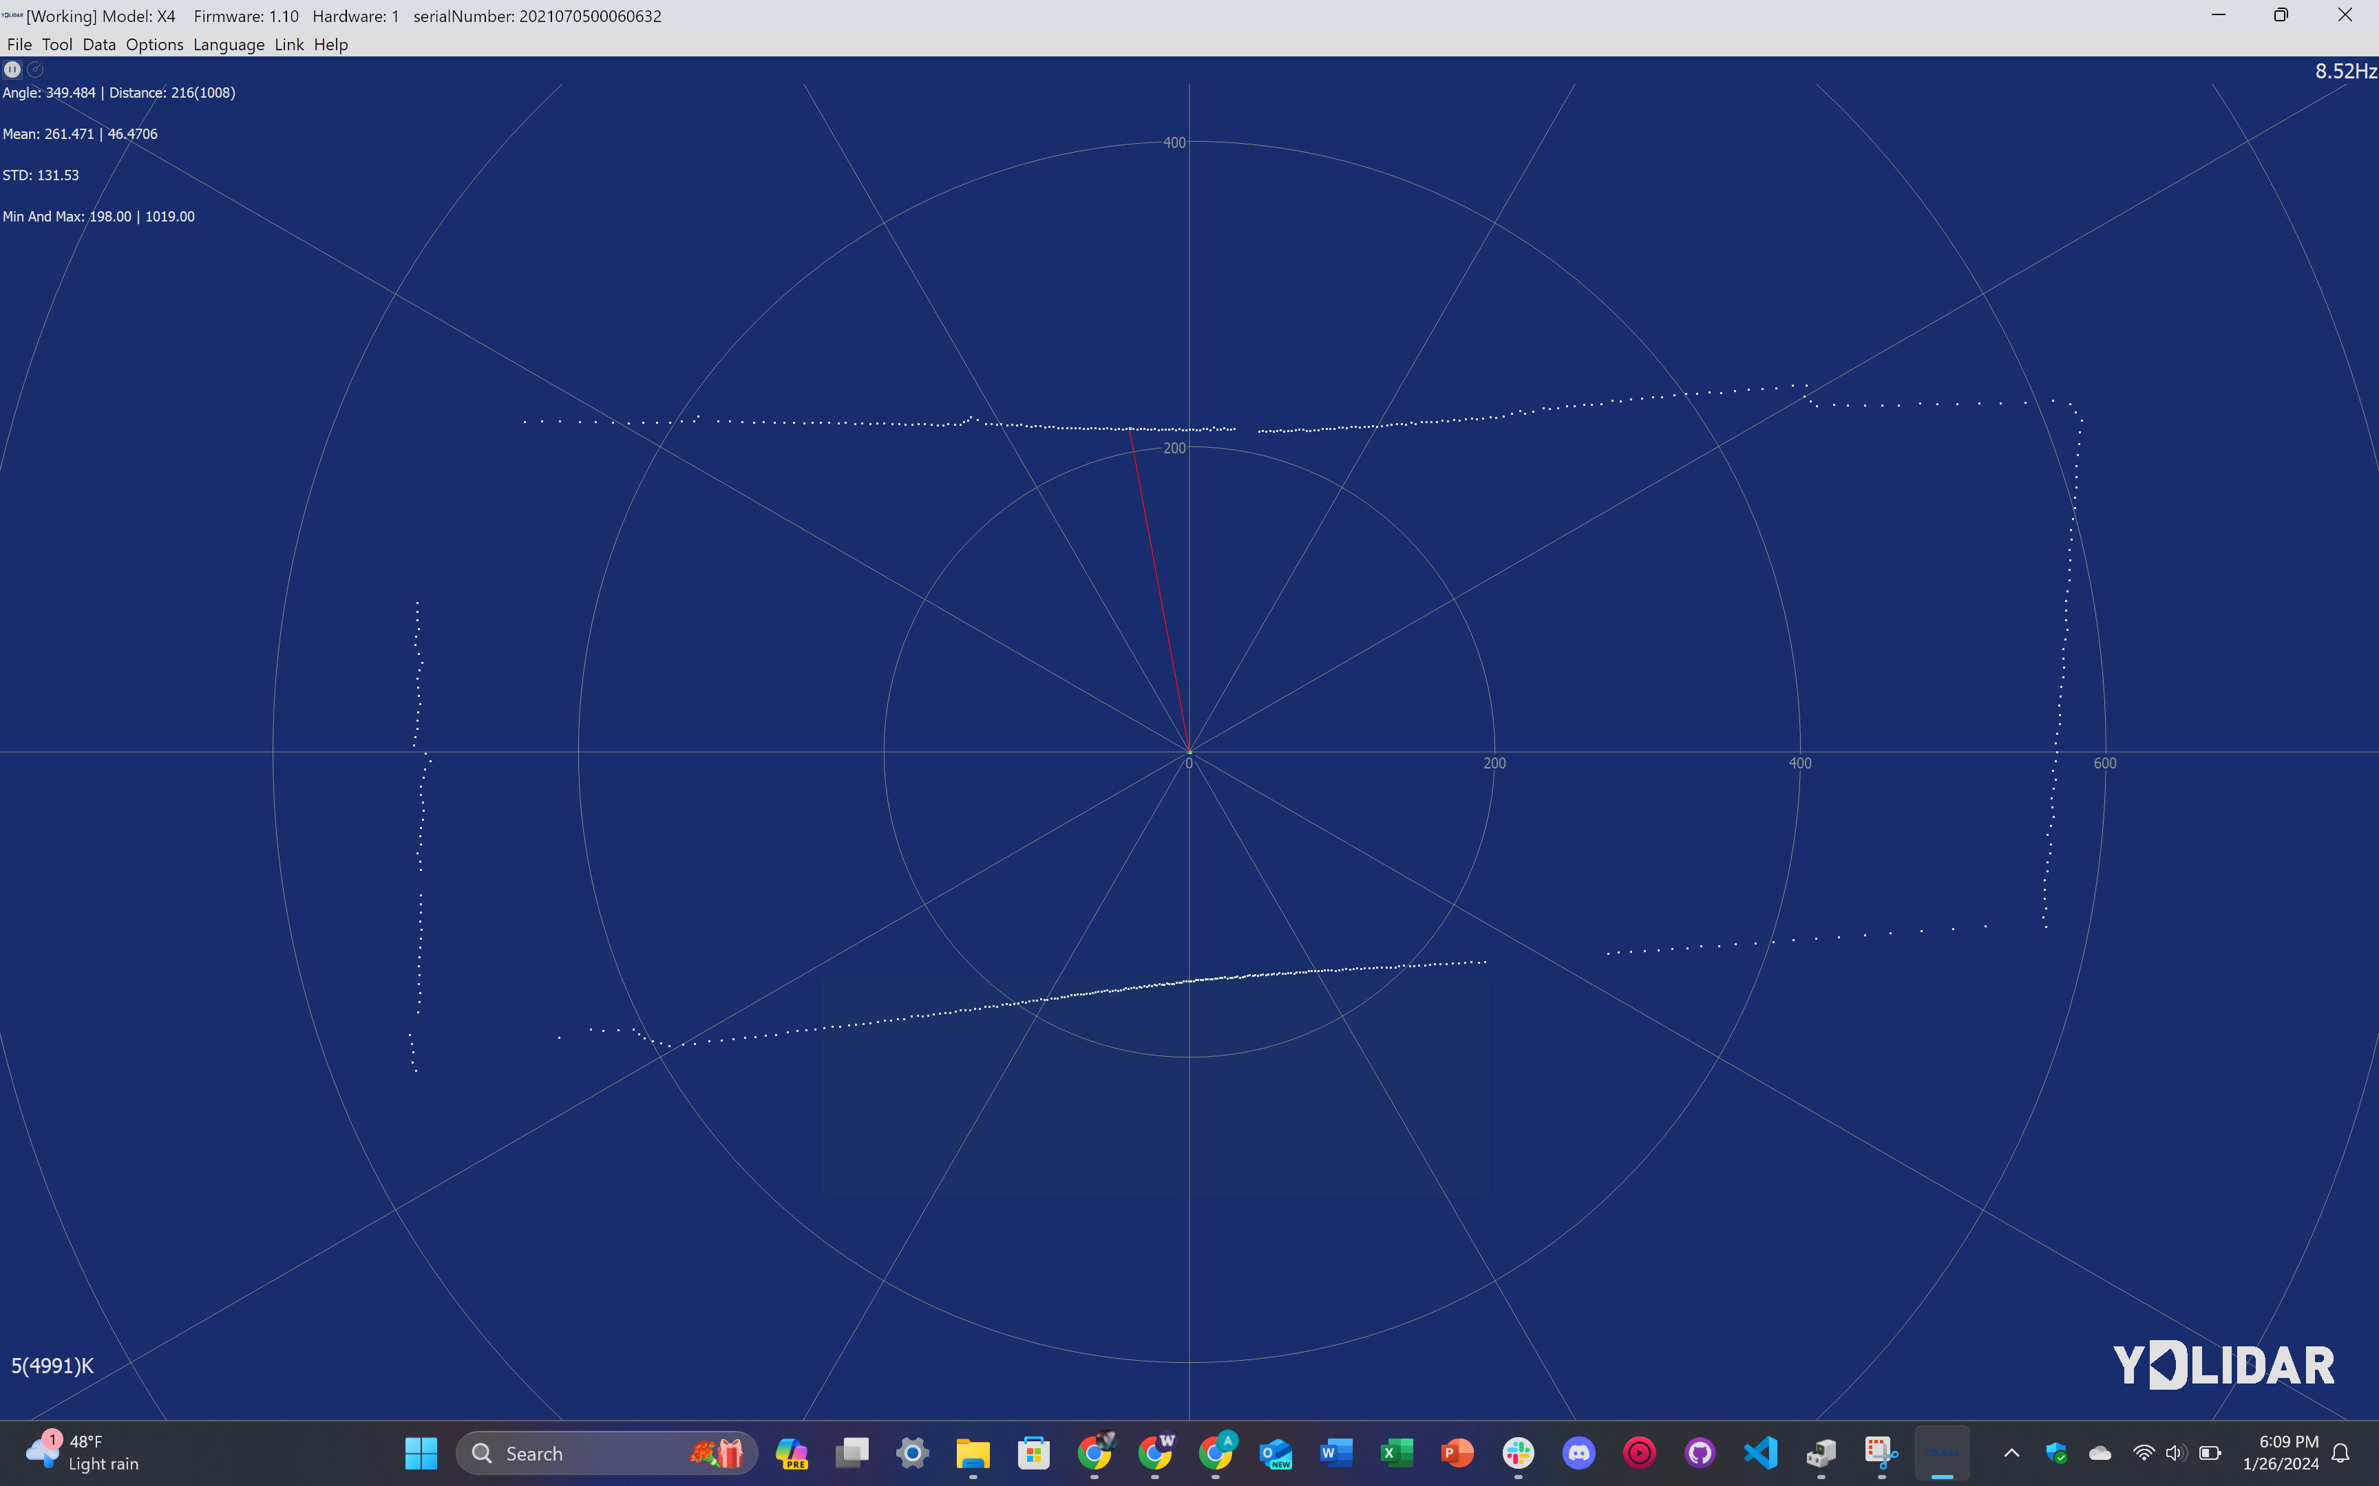

Slide 5
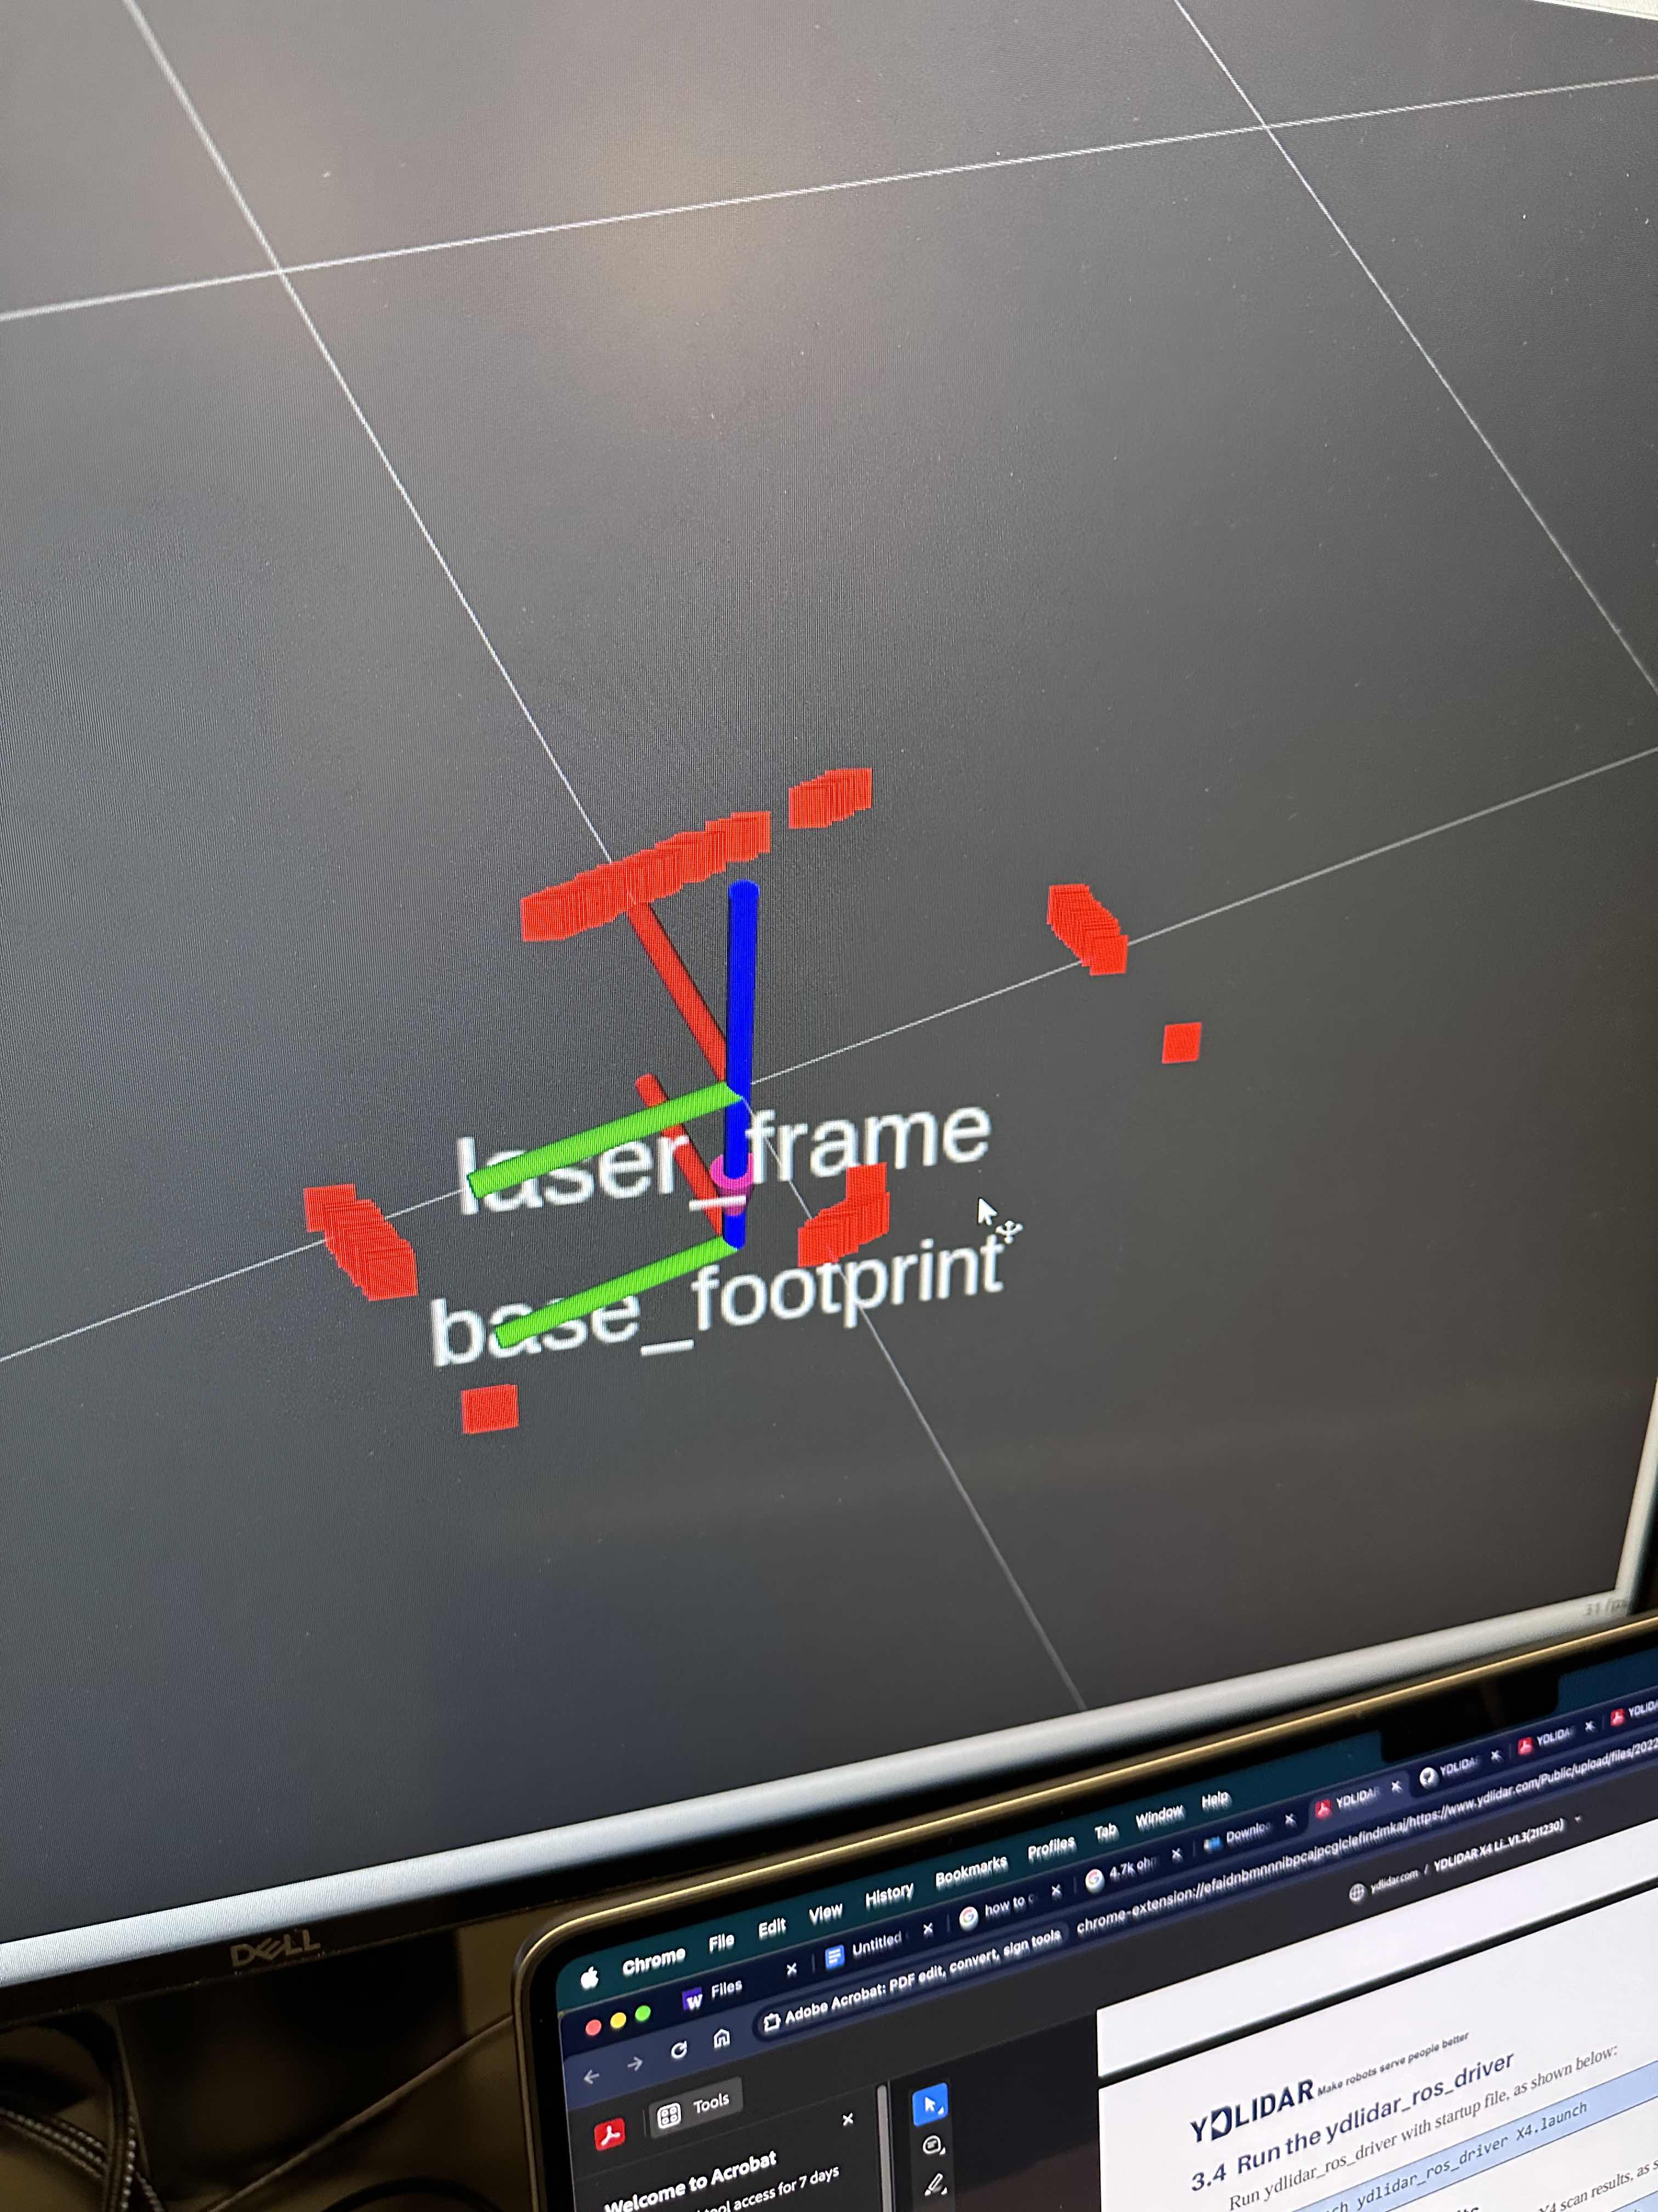
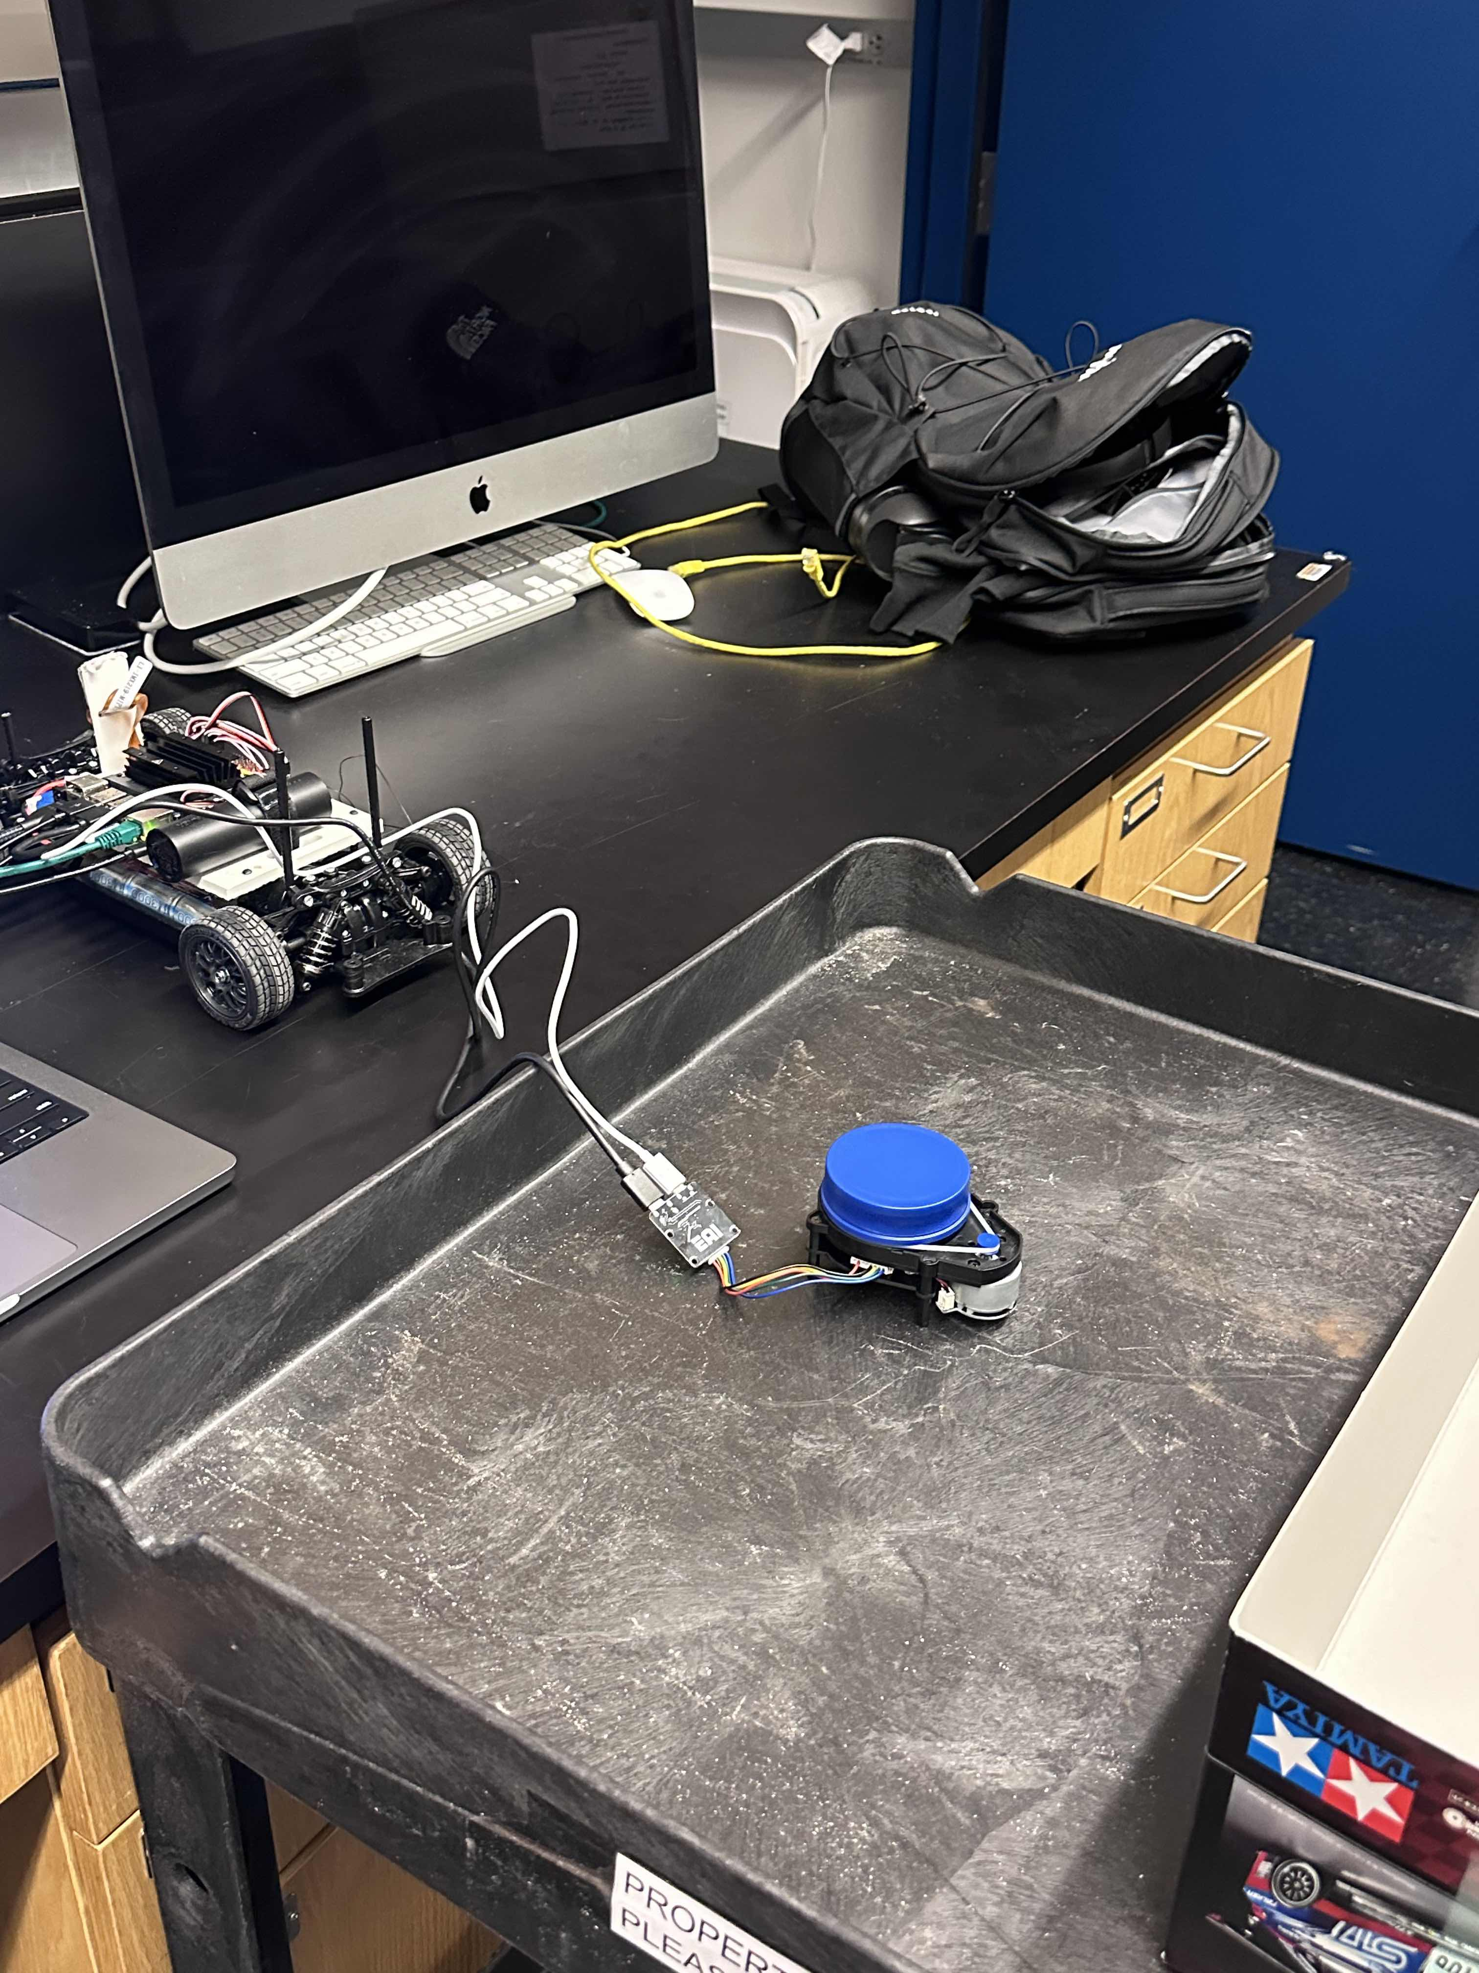
LIDAR: Jarod Marshel
Progress:
Ran LIDAR system on linux to see if it was working correctly
Integrated ROS with the Ylidar X4 and ran the lidar to get a point map of a surrounding area
Next Steps:
Mount LIDAR on two cars
Create a boundary area using SLAM
Figure out how to integrate the SLAM mapping environment with Unity sim.

Slide 6
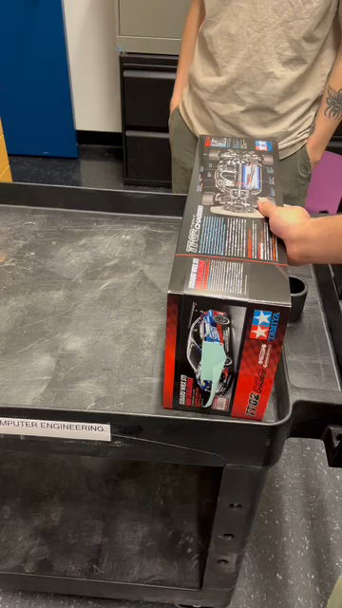

Slide 7
Unity Simulation: Mason
Progress:
Fixed some problems in order to run the simulation.
Optimized the physics between the objects.
Figuring out how to improve the randomness of the soccer game (More training)
Questions/Concerns:
Any specific objectives to achieve?
Is it possible to integrate the Unity AI onto the JetRacer cars? Had the previous teams done it?

Slide 8
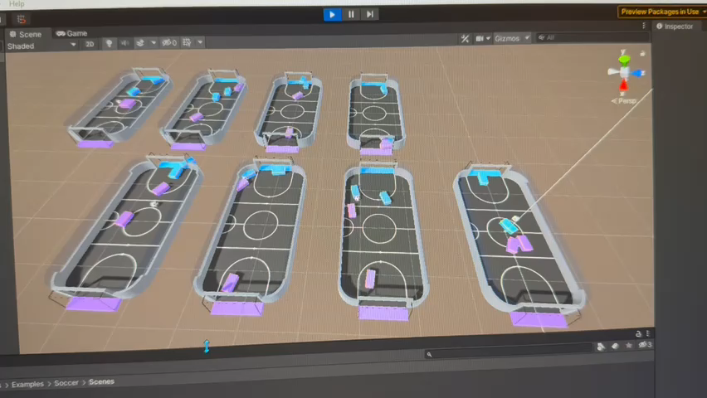

Slide 9
ROS: Casey
Progress:
Determined Melodic is likely the best distribution to use
Set up ROS on robot 4
Set up LiDAR with ROS
Future work:
Continue setting up ROS packages on robot 4
Set up ROS on all 4 robots

Slide 10
ROS: Cooper
Progress:
- Finish LIDAR CAD
- 3D print chassis and LIDAR mount
- Setup ROS Melodic on Car 4
- Setup YDLIDAR ROS driver
Future Work:
Setup ROS Navigation stack
Setup movement node
Setup SLAM
Configure Cars 1- 3
Setup field

Slide 11
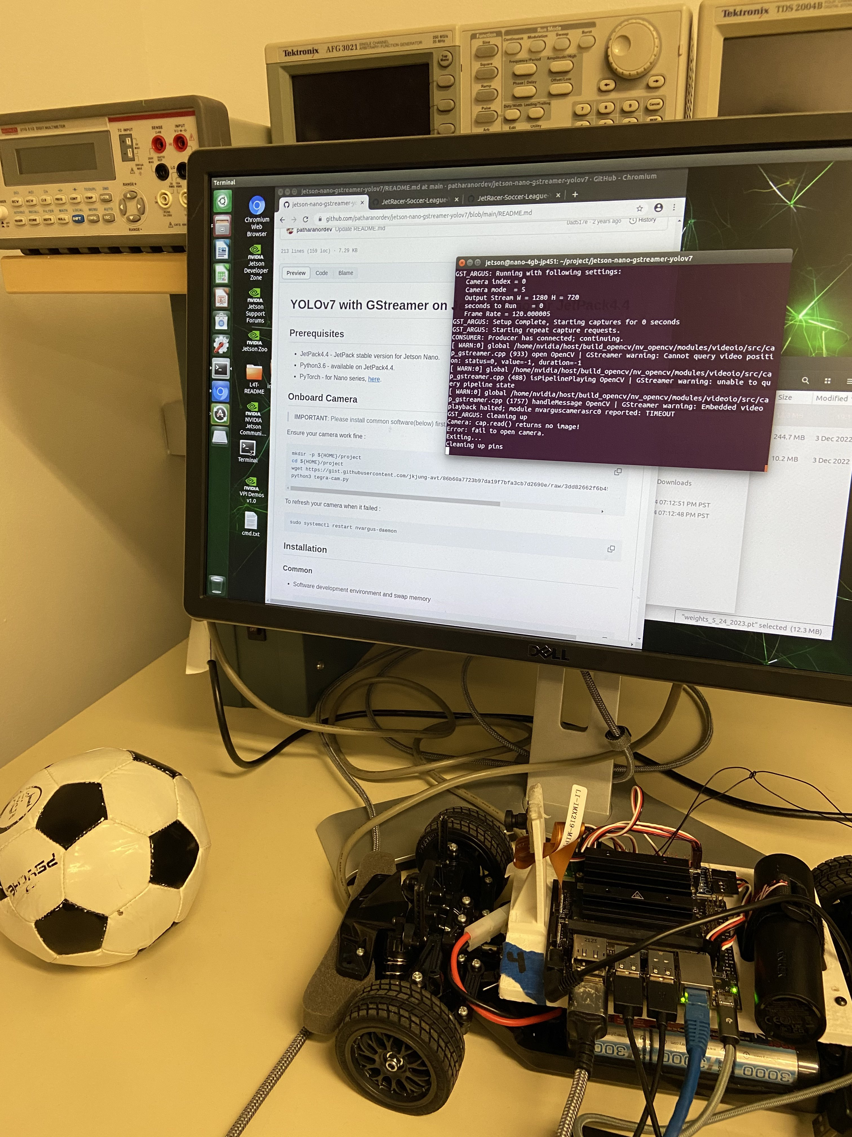
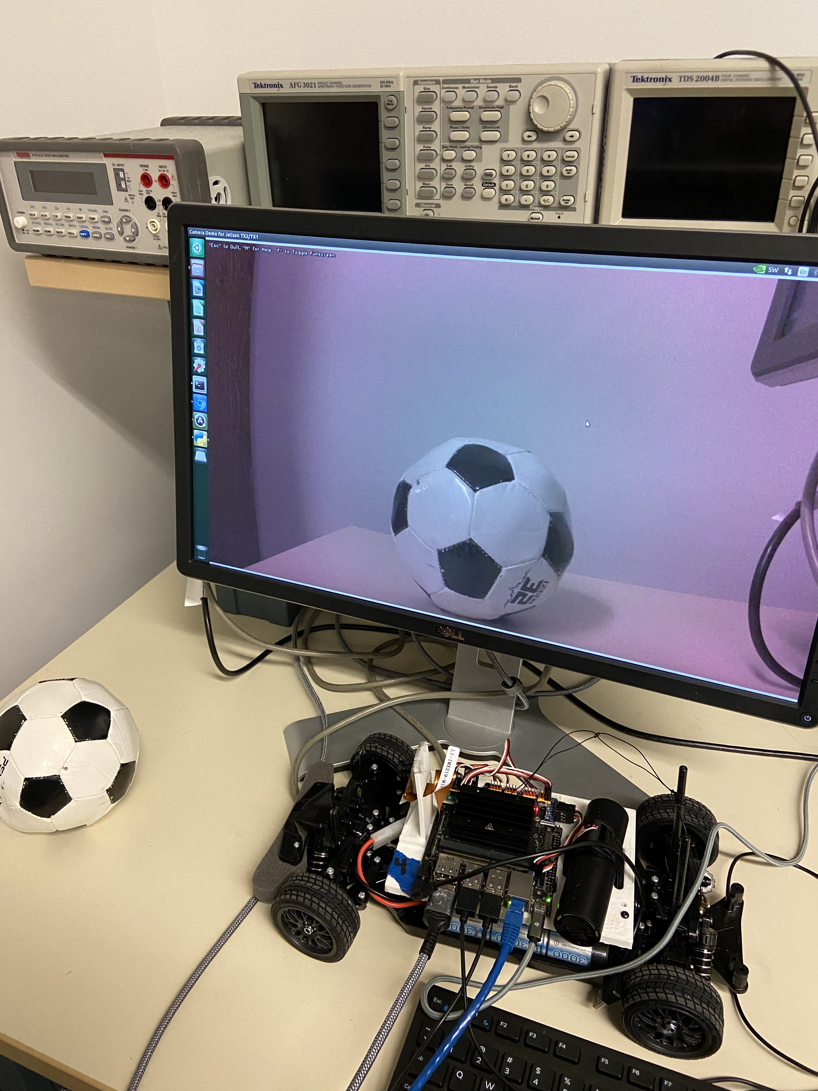
Object Detection: Julie
Progress:
1st year and 2nd year used two different object detection models
1st year (Jetson Inference): good camera, confusing documentation/instructions, dataset uses different soccer ball
2nd year (YOLOv7): camera feed ~4 sec of latency, complete dataset with same soccer ball, multiple different errors when trying to run
First error: Camera failed to open so we restarted it and then got "gstreamer warning cannot query video position"
Current error: Jetracer.nvidia_racecar package cannot be found
Next steps:
Try to implement either model on a different car
May have to create new dataset
Try to use 2nd yr dataset with different model

Slide 12
Object Detection: K
Worked with Julie on everything listed in previous slide
Progress:
1st year and 2nd year used two different object detection models
1st year (Jetson Inference): good camera, confusing documentation/instructions, dataset uses different soccer ball
2nd year (YOLOv7): camera feed ~4 sec of latency, complete dataset with same soccer ball, multiple different errors when trying to run
First error: Camera failed to open so we restarted it and then got "gstreamer warning cannot query video position"
Current error: Jetracer.nvidia_racecar package cannot be found
Next steps:
Try to implement either model on a different car
May have to create new dataset
Try to use 2nd yr dataset with different model

Slide 13
Questions & Concerns
LIDAR crosstalk?
Upgrade to Orin Nano?
Not enough storage (could upgrade SD card)
CV performance lackluster
Next steps with LIDAR? How to use point data?
How to integrate SLAM with ROS LIDAR
Object detection
Which model should we use?
From previous years, did all cars have object detection on them?

